Slide 1
CICD process in Jenkins for React App project.

Slide 2

About myself
Do not be afraid of failure. Be afraid of not have enough courage to try.
Do not be afraid of failure. Be afraid of not have enough courage to try.
As it was before…
As it is now…
My name is Ivan Lovkin. I’m from Mykolaiv.
I'm interesting information technologies. I want to develop in the field of DevOps and information security.
I like studying and learning some new things.

Slide 3
Problem and motivation (about CICD)
As it was before…
As it is now…
Poor code quality
Slow delivery
A lot of handmade
Long search for failures
Lack of feedback
High development costs
Shorter time
Continuous Testing
Shorter Code
Quicker Release
Real-Time Feedback
Customer Satisfaction

Slide 4
General purpose
Process automation
Tools and technology
Skills upgrade
Automate the process of building and delivering (deploying) an application (CI/CD).
Using various tools to create, configure the working environment, configure continuous integration/continuous delivery.
Obtaining new skills and abilities, mastering and consolidating additional knowledge. Practice creating and using CICD practices.

Slide 5
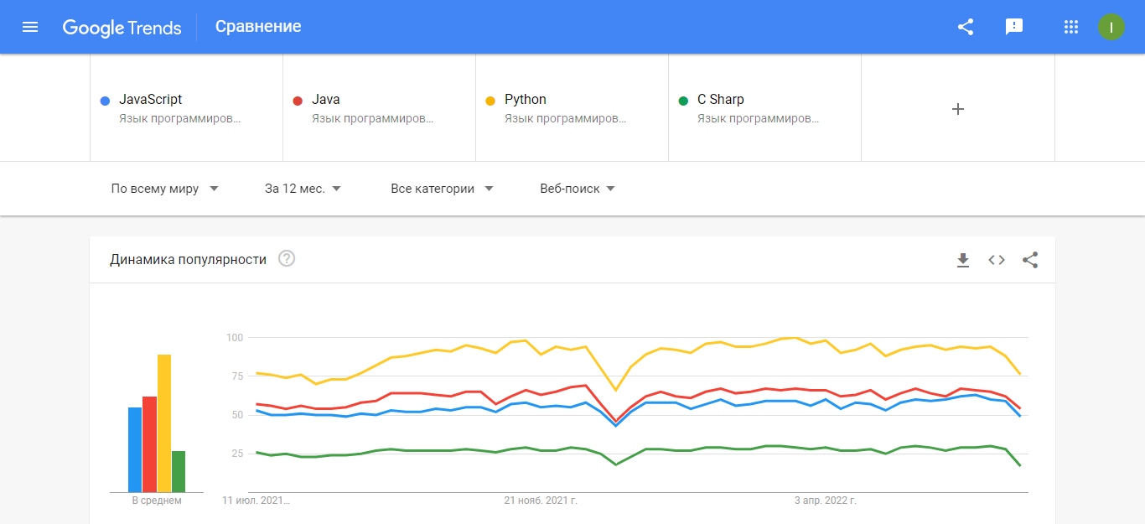
Relevance:
JavaScript remains the most popular language among Ukrainian developers (18.8%). To improve the development process, it is necessary to introduce CICD practices

Slide 6
How it works?

Slide 7
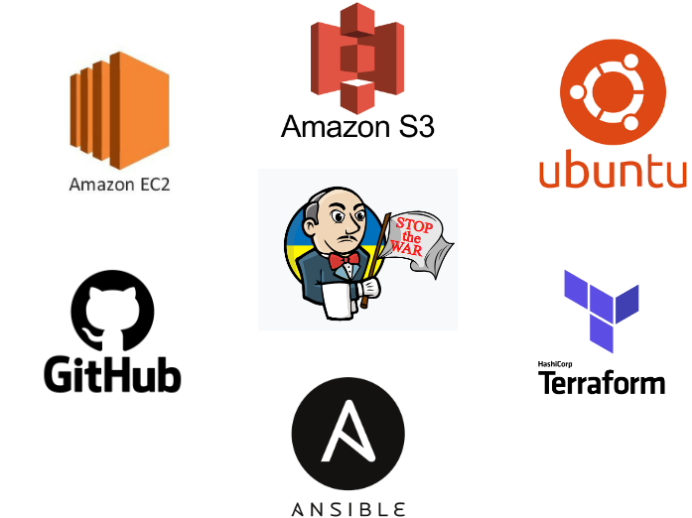
Tools
AWS (EC2, S3) - build infrastructure
Terraform - create environments
Ansible - configure environments
Git, Github - CVS system
Jenkins (master with agent)

Slide 8
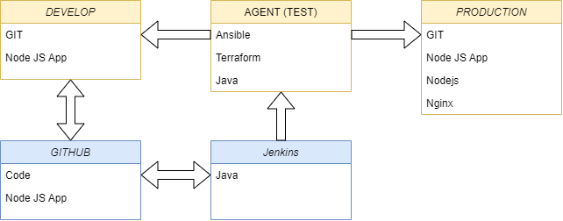
Scheme

Slide 9
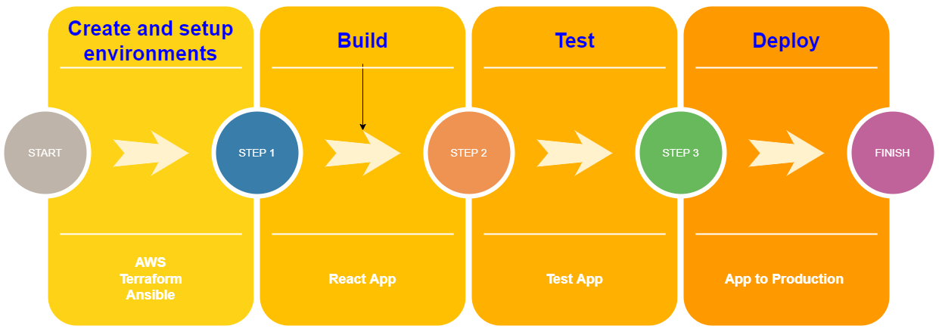
Continuous integration/continuous delivery (deploy)

Slide 10
Links:
https://aws.amazon.com/
https://docs.ansible.com/
https://www.jenkins.io/doc/
https://www.terraform.io/docs
https://create-react-app.dev/docs/getting-started/
https://dou.ua/lenta/articles/language-rating-2022/
https://en.wikipedia.org/wiki/CI/CD

Slide 11
Thank you!

